Slide 1


PaNOSC Overview
Author: Andy Götz (coordinator)+ WP leaders
This project has received funding from the European Union’s Horizon 2020 research and innovation programme under grant agreement No. 823852

Slide 2

PaNOSC factsheet
Call: Horizon 2020 InfraEOSC-04
Partners: ESRF, ILL, XFEL.EU, ESS, CERIC-ERIC, ELI-DC, EGI
Description: cluster of ESFRI Photon and Neutron sources
Observers/non-funded: GÉANT, EUDAT, national RIs
Linked 3rd parties via EGI: DESY, STFC, CESNET
Status: Started 1/12/2018
Github: https://github.com/panosc-eu
Home page: https://panosc.eu
Twitter: @PaNOSC_eu #PaNOSC
Budget: 12 M€
Coordinator: ESRF
Started: 1/12/2018
Duration: 4 years
This project has received funding from the European Union’s Horizon 2020 research and innovation programme under grant agreement No. 823852

Slide 3
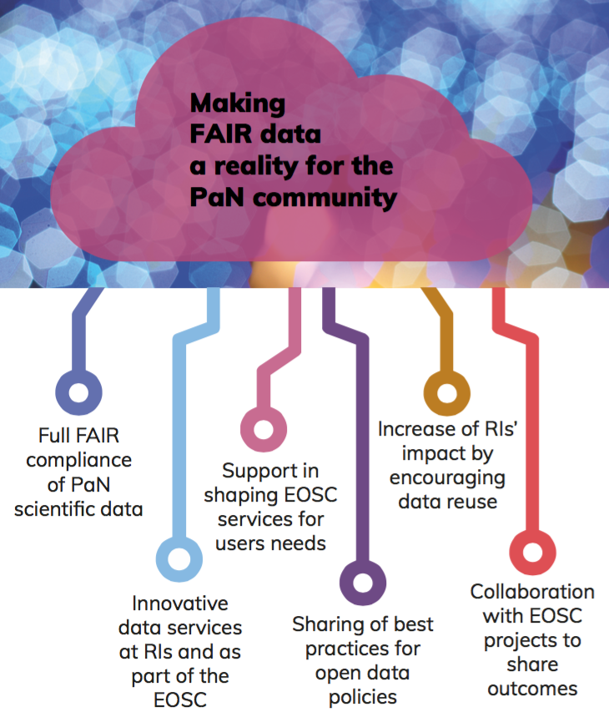
PaNOSC goals
PaNOSC works closely with the PaN sources in Europe to develop common policies, strategies and solutions in the area of FAIR data policy, data management and data services, integrating them into the EOSC.
This project has received funding from
the European Union’s Horizon 2020
research and innovation programme
under grant agreement No. 823852

Slide 4
Data management enables
On-site
data analysis
Publications
Data mining
AI
Open Data Analysed Data Digital Objects
Federated catalogues
On-site data reduction
Reduced Data Archived Data
Data + metadata catalogues
Raw Data
This project has received funding from the European Union’s Horizon 2020 research and innovation programme under grant agreement No. 823852

Slide 5
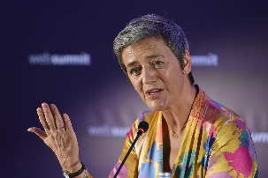
PaNOSC and ExPaNDS are part of a process
2010
Pandata
2020
PaNOSC
202x
EOSC
ExPaNDS
PaN data policy adopted by all photon sources but only a few have implemented it
Nexus/HDF5 adoption increased
SW catalogue grew to 100+ applications
Calipsoplus JRA2 DAAS
Update data policies to be FAIR
Complete implementation of data policies, common API
Implement data services (data download, Jupyter, simulation, data analysis portal)
DMPs, training, link to EOSC
FAIR scientific data generalised
Multi-disciplinary data search, download, transfer
Resources for data storage, archiving, computation
European scientific commons
Science Digital Market (?)

Slide 6

WP2
Data Policies
Update data policies to be
Analysis of PANOSC Data Policies for commonalities and differences https://docs.google.com/spreadsheets/d/1KhQO1-lj8mqYKPvB-VdlCx5loYYsnTcNytxYdJLAy-Y/edit?usp=sharing
Gathered Data Policy Lessons Learned from PaNOSC partners https://docs.google.com/document/d/1TvlkRYgxduADzDeeNjsyReVDtyibnGpp5oH9cFiXpfM/edit?usp=sharing
Plan to Write a Best Practices guide for implementing Data Policies (Implementing FAIR Data Policies Handbook)
Applied for Data Catalogue certification with FAIRsFAIR
Working with the EOSC FAIR working group on applying FAIR in RIs
Provide a service for users for Data Management Plans (DMPs)
This project has received funding from the European Union’s Horizon 2020 research and innovation programme under grant agreement No. 823852

Slide 7
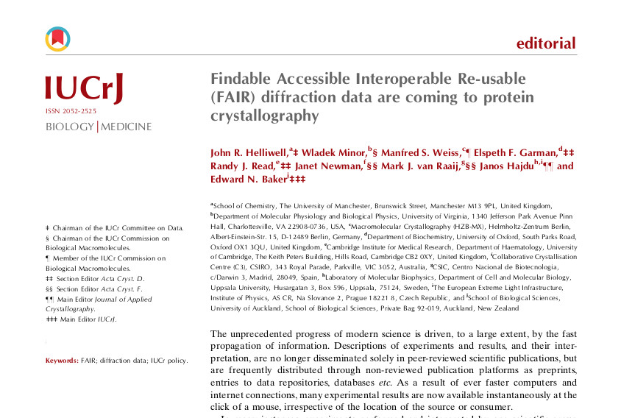
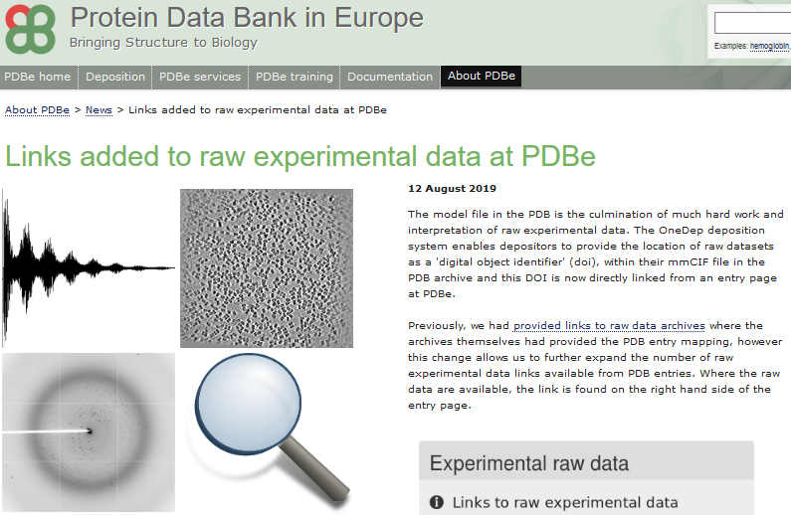
Link raw data to PDBe
WP2
{ "pdbid": "5TOK", "datasets": [ { "data_doi": "10.15785/SBGRID/427", "storage_requirements": "3.2G", "dataset_thumbnail_url": "https://data.sbgrid.org//upload//diffn-png/427/427-diffn.png", "landing_page": "https://data.sbgrid.org/dataset/427" } ] }
This project has received funding from the European Union’s Horizon 2020 research and innovation programme under grant agreement No. 823852

Slide 8
Data catalogue survey
Partner | CERIC | ESS | ELI | ESRF | ILL | XFEL
Catalogue | VUO (online storage NOT a catalogue) | SciCat | TBD | ICAT | ILL Own | myMdC
URL | https://vuo.elettra.trieste.it | https://scicat.esss.se | --- | https://datahub.esrf.fr | https://data.ill.eu | https://in.xfel.eu/metadata
Login required | Yes | Yes | --- | Yes | Yes | Yes
File formats | NeXus, HDF5, ASCII and many others | NeXus | --- | EDF, SPEC, MCA, CBF, CCD, MCCD, HDF5, NeXus | NeXus and ILL Ascii | HDF5
Database | Oracle | MongoDB | --- | Oracle and MongoDB | Oracle | MySQL and PostgreSQL
Language | Plsql, Python | Javascript | --- | JAVA and Javascript | PHP | App: Ruby(onRails), Client: Python
Main technologies | WebDAV, Guacamole | Angular | --- | React, NodeJS, EJB, JPA | Symfony, JQuery | Rails
Number of public datasets/files | 0/0 | 181/250,000 | --- | ~540K/157M | ~250K/4M | 0/0
Using OAI-PMH | No | Not yet installed | --- | No | No | No
Minting DOIs | Yes | Yes | --- | Yes | Yes | Yes
Data/embargo policy | Not defined | Embargoed for 3 years | --- | Embargoed for 3 years, ESRF Data Policy | Embargoed for 3 to 5 years, ILL Data Policy | Embargoed for 3 with possible extension to 5 years, XFEL Data Policy
Number of instruments connected to data catalogue | None | 1 | --- | 17 | 54 | 16
WP3

Slide 9
Data catalogue progress
WP3
Fair Data API development
Identified two sides of EOSC Integration:
Harvesting Data by EOSC Agents and Repos
FAIR Data Search to be federated
Existing catalogues and their capabilities as well as third-party options for implementations have been surveyed. Prototypes are being discussed at a WP3 meeting in Grenoble next week.
NeXus Survey for Ontologies
Facility practises and plans around file formats are being shared in sessions with partners. Identified commonalities can be applied everywhere and inform the catalogue search task.
Both Tasks link well with ExPaNDS WP3 – Alun’s talk.
This project has received funding from the European Union’s Horizon 2020 research and innovation programme under grant agreement No. 823852

Slide 10
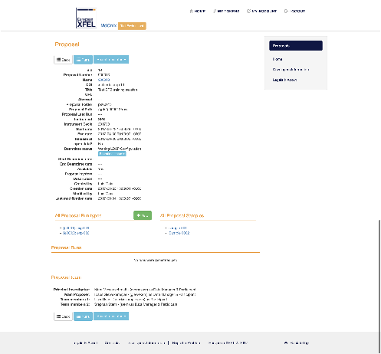
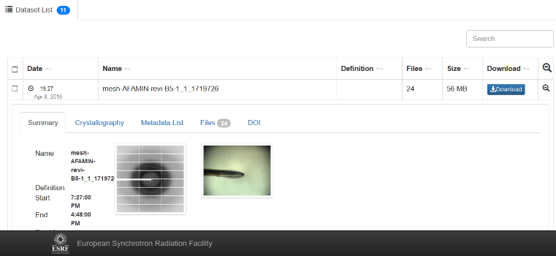
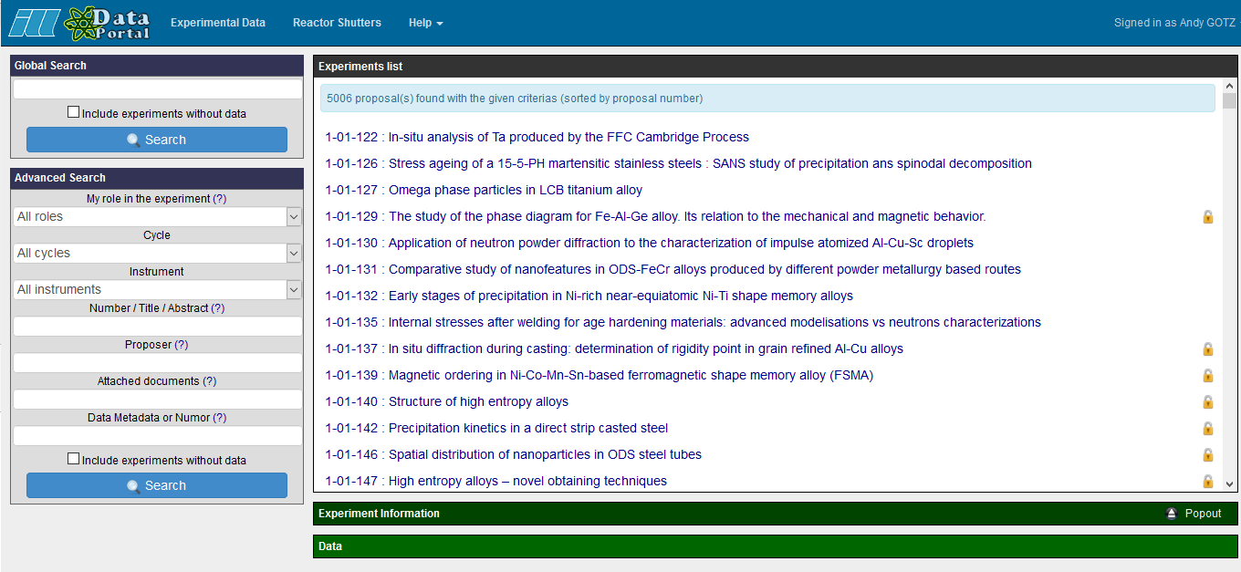
PaNOSC has 6 data catalogues with different APIs + UIs
WP3
ESRF
(icat)
CERIC
(icat)
ESS
(SciCat)
ILL
(local)
ELI
(tbd)
XFEL
(MyMdc)
This project has received funding from the European Union’s Horizon 2020 research and innovation programme under grant agreement No. 823852

Slide 11

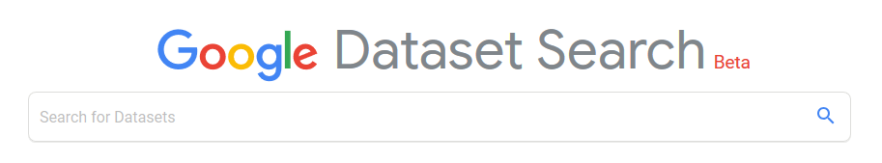
PaNOSC common API across all sites
WP3
Common API to search across all PaNOSC catalogues
ESRF
(icat)
CERIC
(icat)
ESS
(SciCat)
ILL
(local)
ELI
(tbd)
XFEL
(MyMdc)
This project has received funding from the European Union’s Horizon 2020 research and innovation programme under grant agreement No. 823852

Slide 12
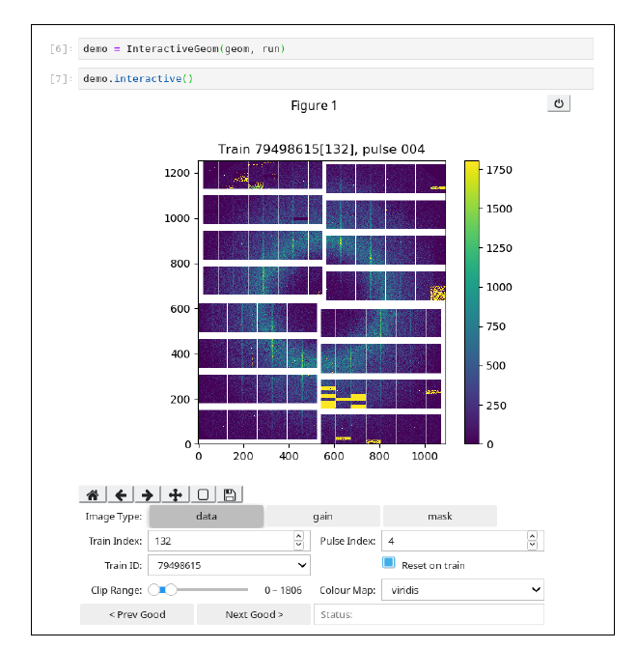
WP4
Data Analysis Services - choices
Jupyter Notebooks
VISA Remote Desktop in Browser
Remote data analysis portal (ILL+ESRF)
HDF5 and visualisation in notebooks (EuXFEL, ILL, ESRF, ESS)
This project has received funding from the European Union’s Horizon 2020 research and innovation programme under grant agreement No. 823852

Slide 13
WP4
Data Analysis Services progress
Recruitment of staff
Identify key science users and scientific use
Research literature on computational workflows
Move analysis capabilities into Jupyter notebook
Moving analysis tools into containers to run analysis out of containers (EuXFEL, ESRF)
Started to design remote analysis architecture (ILL+ESRF)
HDF5 and visualisation in notebooks (EuXFEL, ILL, ESRF, ESS)
Questionnaire on data analysis for participating facilities as been sent out (Task 4.1)
Engage with other Work Packages and initiatives
https://github.com/panosc-eu/panosc/tree/master/Work%20Packages/WP4%20Data%20analysis%20services/use_cases

Slide 14
Simulation services - ViNYL
WP5
Virtual Neutron and x-raY Laboratory (ViNYL) will:
Offer services for simulation and modelling of photon and neutron instruments, as well as start-to-end simulations to describe entire experiments at photon and neutron facilities
Make simulation data services inter-operable among the involved partners, such as OASYS, McSTAS and SIMEX
Enable RIs to seamlessly link this experiment simulation services to their in-house data reduction, analysis, and visualization infrastructures.
SIMEX is responsible for photon experiment simulations
This project has received funding from the European Union’s Horizon 2020 research and innovation programme under grant agreement No. 823852

Slide 15
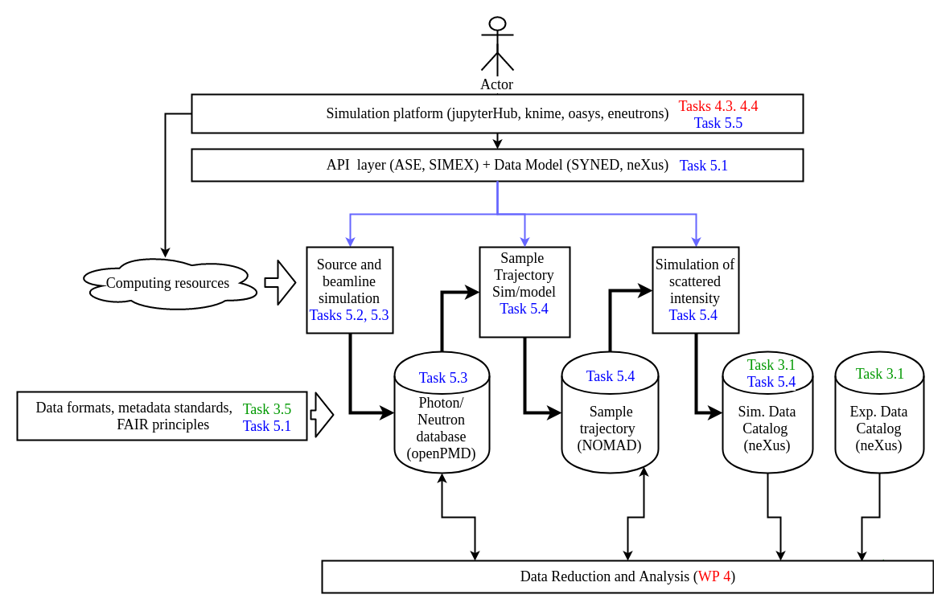
Simulation services - ViNYL
WP5
SIMEX: Start-to-end photon experiment simulation library (python)
McStas-script: python API for Neutron ray-tracing with McStas
OASYS: Wavefront propagation for beamline design (WISE)
EPOCH particle in cell + McStas: Simulation of laser driven neutron sources and ray tracing
This project has received funding from the European Union’s Horizon 2020 research and innovation programme under grant agreement No. 823852

Slide 16
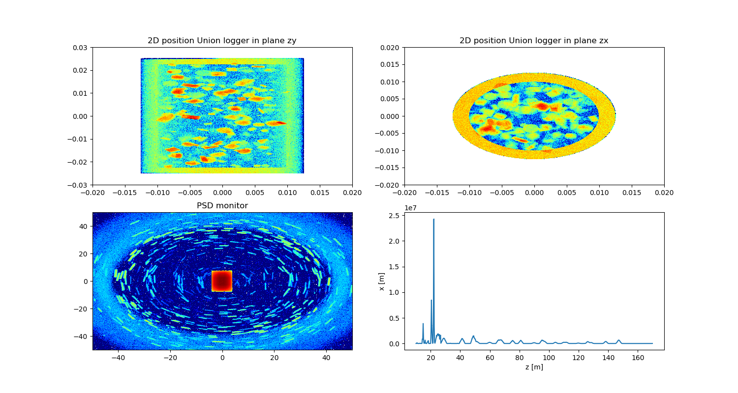
McStasScript
WP5
Syntax example
Instr = instr.McStas_instr(”demo_instrument")
source = Instr.add_component(”source”, ”Source_simple”)
source.xwidth = 0.12; source.yheight = 0.12
source.lambda0 = 5.0; source.dlambda = 3.0
sample = Instr.add_component(”sample”, ”PowderN”,
AT=[0,0,1], RELATIVE=”source”)
sample.radius = 0.01; sample.yheight = 0.03
sample.reflections = ”\”Cu.laz\””
[… add monitors …]
Data = Instr.run_full_simulation(foldername=”demo”, ncount=1E7)
Data[0].Intensity += 12.2 # Add artificial background
functions.make_sub_plot(Data) # plots the simulated data
Python API for McStas
Build instrument
Run simulation
Access produced data
Plotting functionality
Developed in PaNOSC WP5
Example: Powder simulated as crystals
Scattering in sample
Intensity on detector
Sample y [m]
Detector y [cm]
Sample x [m]
Detector x [cm]

Slide 17
EOSC Integration – AAI i.e user identity
WP6
How to integrate umbrellaID and EOSC ?
How to face the new regulations & requirements?
July 2019 - Decision of the Umbrella partners to work with eduTEAMS (GÉANT).
September 2019 - Pilot (core umbrellaID scope functionalities) available
October 2019 - work on the migration (transfer of the users EAAH, Communication with users, discussion on Authorisation …)
This project has received funding from the European Union’s Horizon 2020 research and innovation programme under grant agreement No. 823852

Slide 18
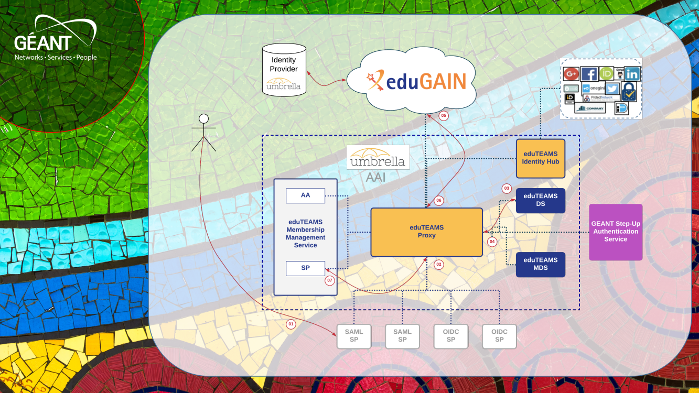
WP6
Credits: Christos Kanellopoulos (GÉANT)

Slide 19
EOSC Integration – Data transfer
WP7
3 uses cases :
User driven data transfer (e.g. Globus Online)
Data archiving for RI (STFC as the archive center)
Transfer from RI to compute facilities on behalf of users (i.e. based on the scenario where users perform analysis on a different infra than the one of the RI where the data have been produced). Currently exploring OneData, dCache and simple solution without caching (webdav)
Starting pilots with EGI Support of UC 2 &3, evaluating :
Integration with the existing RI IT infra
AAI interoperability
limit of the model in terms of data volume
This project has received funding from the European Union’s Horizon 2020 research and innovation programme under grant agreement No. 823852

Slide 20
Sustainability
WP7
Stakeholders for the Photon and Neutron community
The database of stakeholders will be used to involved stakeholders and get feedback via targeted questionnaires and interviews. The feedback from stakeholders will allow us to address the other tasks
Metrics and cost for the Photon and Neutron community
Analysis and development of metrics for the evaluation of costs and added value of the services provided to the community . We are currently working at the development of an auditable cost model template and metrics to evaluate the added value of services which will be computed by tools like PUMA, VUO and others
This project has received funding from the European Union’s Horizon 2020 research and innovation programme under grant agreement No. 823852

Slide 21
PUMA publication metrics
Publications and citations per instrument
Delay between a proposal and a publication
Countries and laboratories which use ILL (ESRF, …) data
Look for potential new users
Scientific trends
Impact factor per science facility
This project has received funding from the European Union’s Horizon 2020 research and innovation programme under grant agreement No. 823852

Slide 22

Stakeholders
WP7
PaN user community
EOSC bodies
EOSC Secretariat
EOSC Governing Board
EOSC Executive Board
EU PaN sources
PaNOSC partners / bodies & national PaN RIs (managers, bodies, staff, IT professionals)
Media &
general public
EC, national authorities and funding agencies, policy makers
Community of RIs from other clusters
ENVRI-FAIR
EOSC-LIFE
ESCAPE
SSHOC
e-infrastructures
EGI
Géant
PRACE
RDA Europe
Other EOSC-related projects
EOSC-Hub
GO FAIR
FAIRsFAIR
OpenAIRE
Researchers from academia & industry
PRACE
host members
ERICs’ community
ERIC Forum
ESFRI
This project has received funding from the European Union’s Horizon 2020 research and innovation programme under grant agreement No. 823852

Slide 23
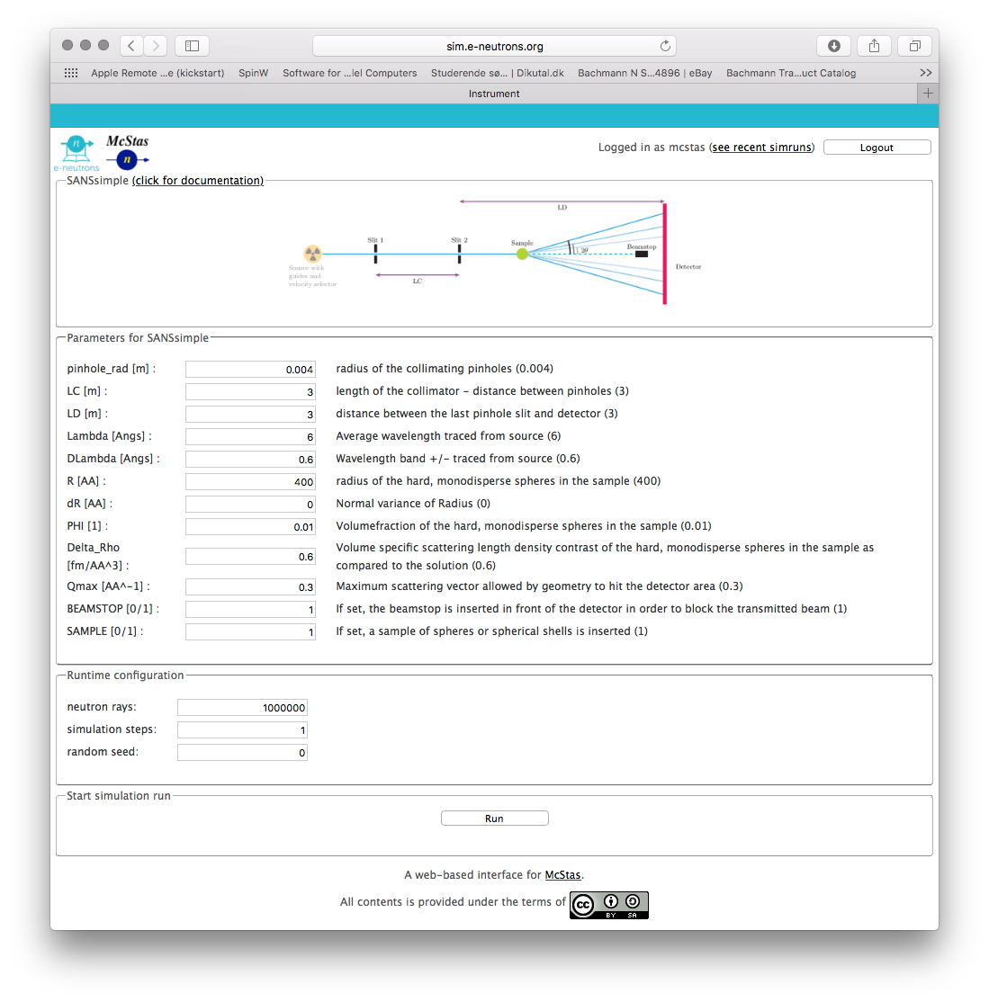


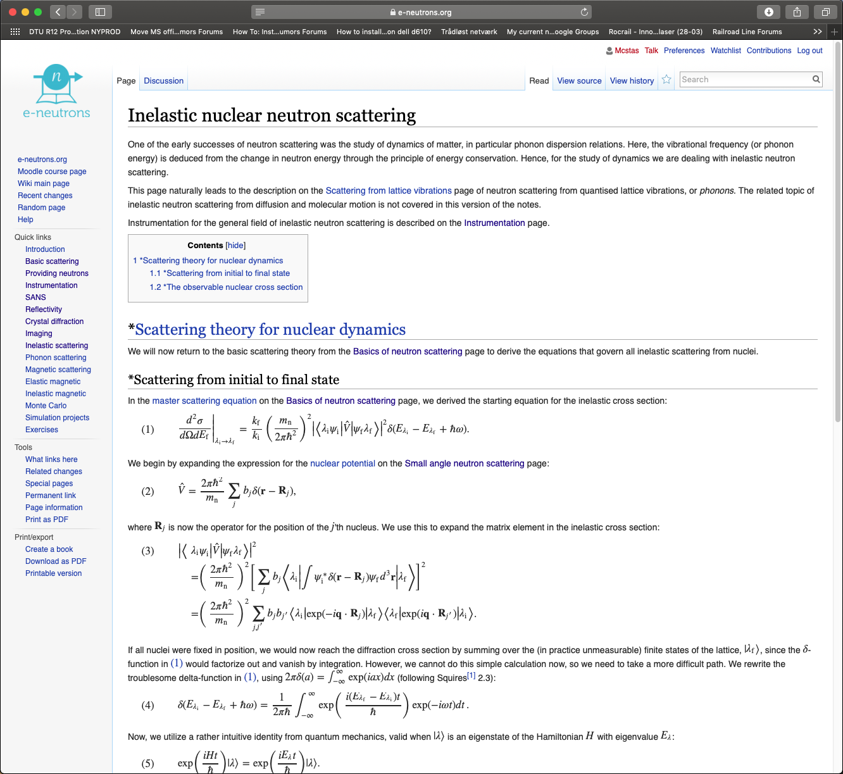
e-learning
WP8
e-neutrons.org
Wiki with neutron scattering theory
Web instrument simulation using McStas
Quizzes using both theory and simulation
Migration to ESS servers underway
Extensions:
Support for Jupyter Notebooks
Integrate WP 4 data analysis services
Integrate WP 5 simulation services
This project has received funding from the European Union’s Horizon 2020 research and innovation programme under grant agreement No. 823852

Slide 24

Internal communications
WP9
GitHub repositories for the storage of project’s documents and the management of the project and its team:
PaNOSC (https://github.com/panosc-eu/panosc), or common issues and general information about the project;
Wiki (https://github.com/panosc-eu/panosc/wiki), with basic information about the project, its partners and its scope, which is used as the temporary project’s website until the official one is published;
Issues (https://github.com/panosc-eu/panosc/issues), used for discussion on all PaNOSC issues.
Google Drive and Docs to store and share working documents, and to edit them collaboratively.
CERIC drive – to store and share confidential documents related to the project.
This project has received funding from the European Union’s Horizon 2020 research and innovation programme under grant agreement No. 823852

Slide 25
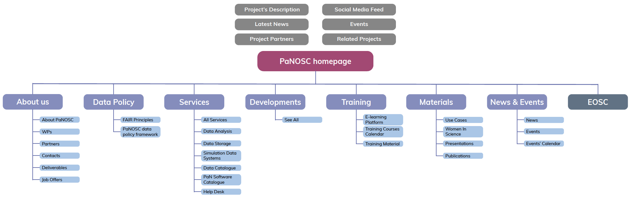
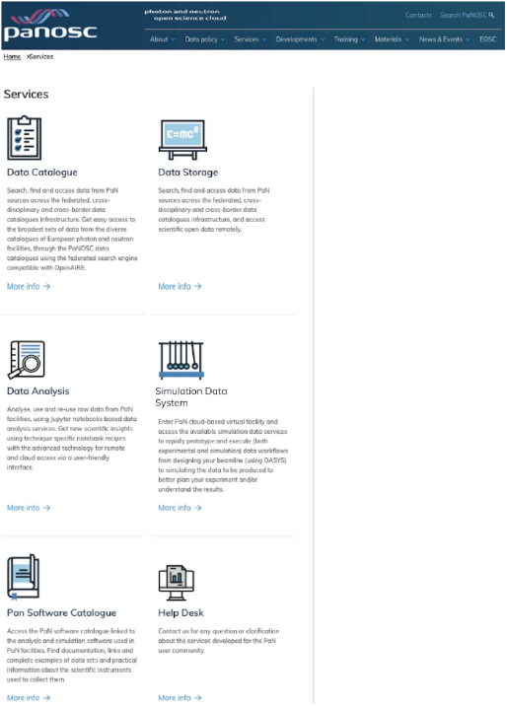
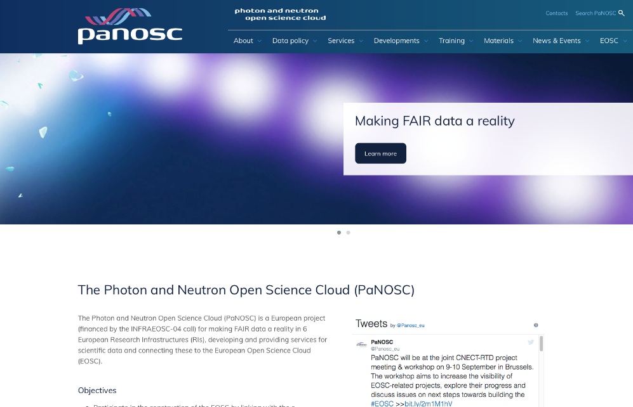
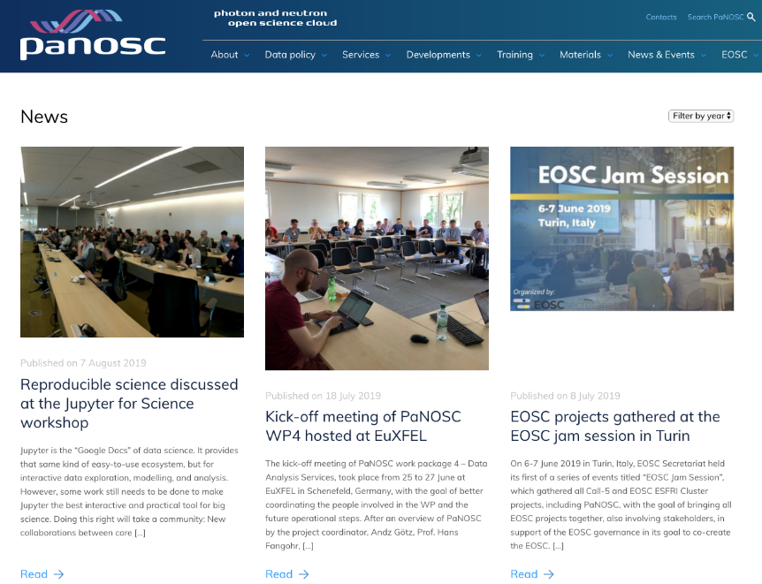
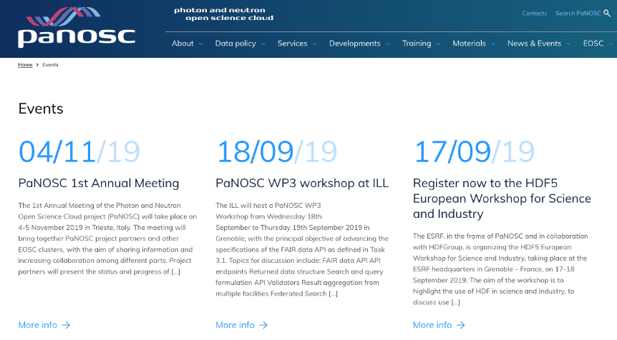
PaNOSC website – https://panosc.eu
WP9

Slide 26
Attended events
WP2 WP4 WP6 WP9
Staff and managers from PaNOSC partners introduced PaNOSC to different audiences (including RIs technical staff and managers, policy makers, researchers and service providers), and to discuss future plans and developments. Attended events in which PaNOSC speakers were actively present include:
ESFRI RIs and EOSC Workshop, 30 January 2019, London – UK
ESCAPE kick-off meeting, 7-8 February 2019, Paris – France
FAIRsFAIR kick-off meeting, 14-15 March 2019, Amsterdam – The Netherlands
EOSC-hub week, 10-12 April 2019, Prague – Czech Republic
EGI Conference, 6-8 May 2019, Amsterdam – The Netherlands
LEAPS-IT, CalipsoPlus + UmbrellaID @PSI, 13-15 May 2019, Villigen – Switzerland
“Dashboarding with project Jupyter” workshop – 3-6 June 2019, Paris – France
Jupyter for Science workshop, 11-13 June 2019, Berkeley - USA
Joint EOSC project meeting, 9-10 September 2019, Brussels - Belgium
This project has received funding from the European Union’s Horizon 2020 research and innovation programme under grant agreement No. 823852

Slide 27
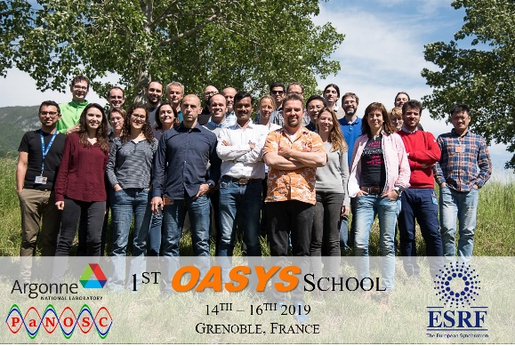

Organized events
WP2 WP3 WP4 WP5
1st PaNOSC OASYS School, 14-16 May 2019, Grenoble – France
WP3 kick-off meeting on FAIR data API, federated search with EOSC hub, catalog integration – May 2019, Copenhagen – Denmark
WP4 kick-off meeting on Data Analysis services, with focus on visualisation tools and hdf5, virtual hdf5 data sets, h5glance and h5py, and computational environments such as JupyterHub and BinderHub, 25-26 June 2019, Schenefeld – Germany
UPCOMING EVENTS:
HDF5 European Workshop for Science and Industry, 17-18 September 2019, @ESRF, Grenoble
h5py code camp, 19-20 September 2019, @ESRF, Grenoble
WP3 face-2-face meeting, 18-19 September 2019, @ ILL, Grenoble
PaNOSC 1st Annual Meeting, 4-5 November 2019, @CERIC-ERIC, Trieste - Italy

Slide 28
PaNOSC KPIs
 | ILL | ESRF | CERIC | XFEL | ELI | ESS
Data/year 2018 | 0.2 PB | 8 PB | 1 PB | 3PB | < 1 PB | 0
Data/year 2023 | 0.6 PB | 50 PB | 15 PB | 100 PB | 10 PB | < 1 PB
Data Policy 2018 | 2011 | 2016 | 2014(3/8) | 2017 | in prog | 2017
Data Policy 2023 | 2011 | 2016 | 2019 | 2017 | 2019 | 2017
Metadata catalogue 2018 | Local | Icat | Local | myMdC | No | SciCat
Metadata catalogue 2023 | Local | Icat | Icat | myMdC | [TBD] | SciCat
Metadata definition 2018 | Nexus | Nexus | custom | myMdC | ? | Nexus
Metadata definition 2023 | Nexus | Nexus | Nexus | Nexus | [Nexus] | Nexus
DOI 2018 | yes | yes | no | yes | no | yes
DOI 2023 | yes | yes | yes | yes | yes | yes
This project has received funding from the European Union’s Horizon 2020 research and innovation programme under grant agreement No. 823852

Slide 29
PaNOSC KPIs
 | ILL | ESRF | CERIC | XFEL | ELI | ESS
Open Data 2018 | 100s | 2 | 0 | 10s | 0 | 0
Open Data 2023 | 1000s | 1000s | 100s | 1000s | 100s | 10s
Data Services 2018 | Pilot | In progress | Remote | In progress | ? | In progress
Data Services 2023 | Desktop Jupyter | Jupyter Desktop | Jupyter Desktop | Jupyter Desktop | Desktop Jupyter | Jupyter Desktop
Common data API 2018 | No | No | No | No | No | No
Common data API 2023 | Yes | Yes | Yes | Yes | Yes | Yes
User training 2018 | No | No | No | No | No | No
User training 2023 | Yes | Yes | Yes | Yes | Yes | Yes
This project has received funding from the European Union’s Horizon 2020 research and innovation programme under grant agreement No. 823852

Slide 30
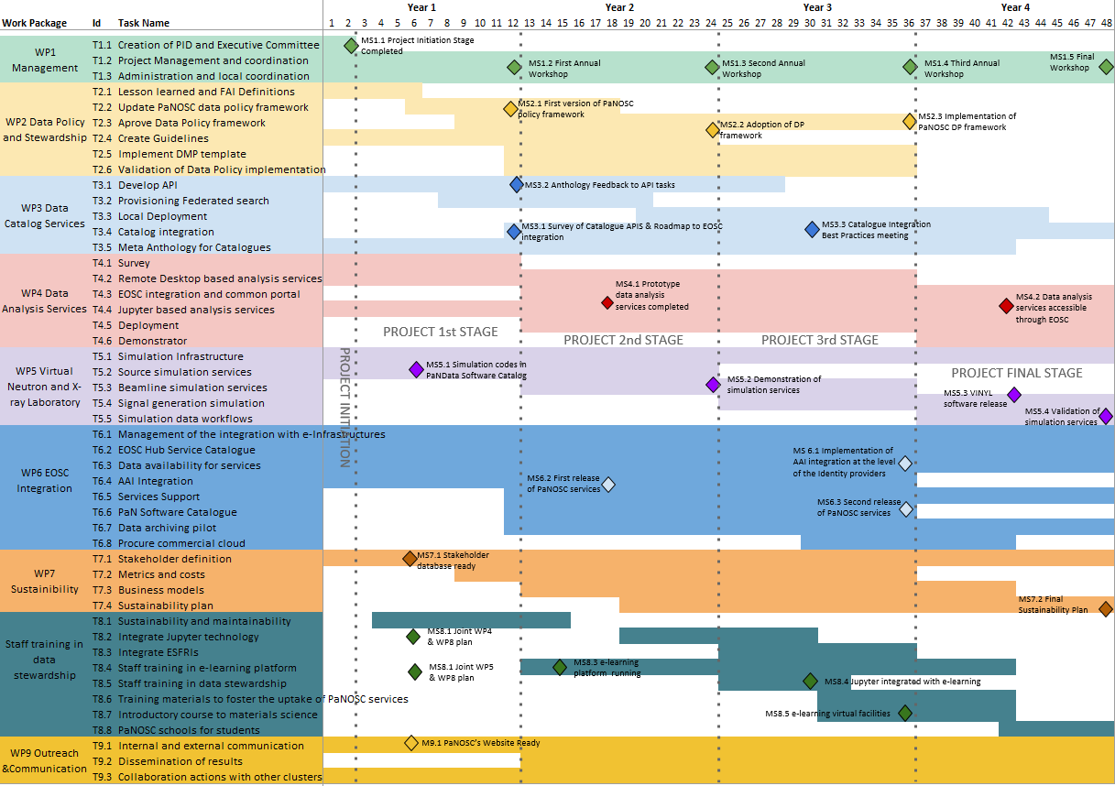
PaNOSC Milestones

Slide 31
Deliverable status in September 2019
Completed
D1.1 – Project Initiation Documentation
D9.3 – Repository for internal communications D1.2 – Mid-year summary
D1.4 – Data Management Plan
D9.2 – Website
This project has received funding from the European Union’s Horizon 2020 research and innovation programme under grant agreement No. 823852

Slide 32
Milestones status in September 2019
Completed
MS1.1 – Project Initiation Stage
MS5.1 – Simulation codes in PaNdata catalog
MS7.1 – Stakeholder database
MS8.1 – Joint WP4 and WP8 plan
MS8.1 – Joint WP5 and WP8 plan
MS9.1 – PaNOSC website ready
This project has received funding from the European Union’s Horizon 2020 research and innovation programme under grant agreement No. 823852

Slide 33
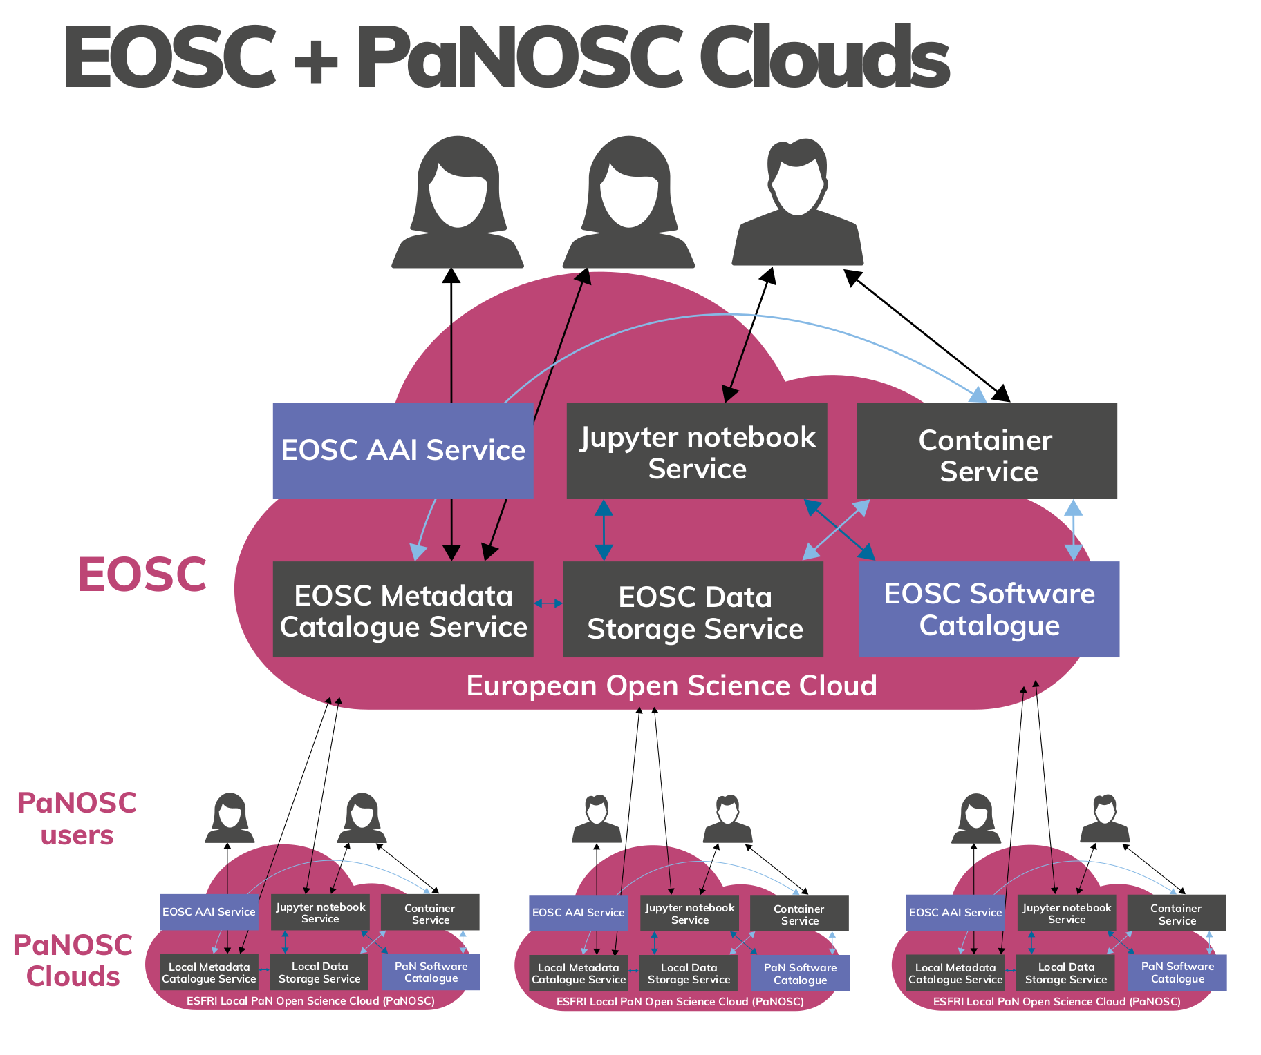

Our Vision – a PaN scientific commons
This project has received funding from the European Union’s Horizon 2020 research and innovation programme under grant agreement No. 823852

Slide 34

How to avoid this …

Slide 35
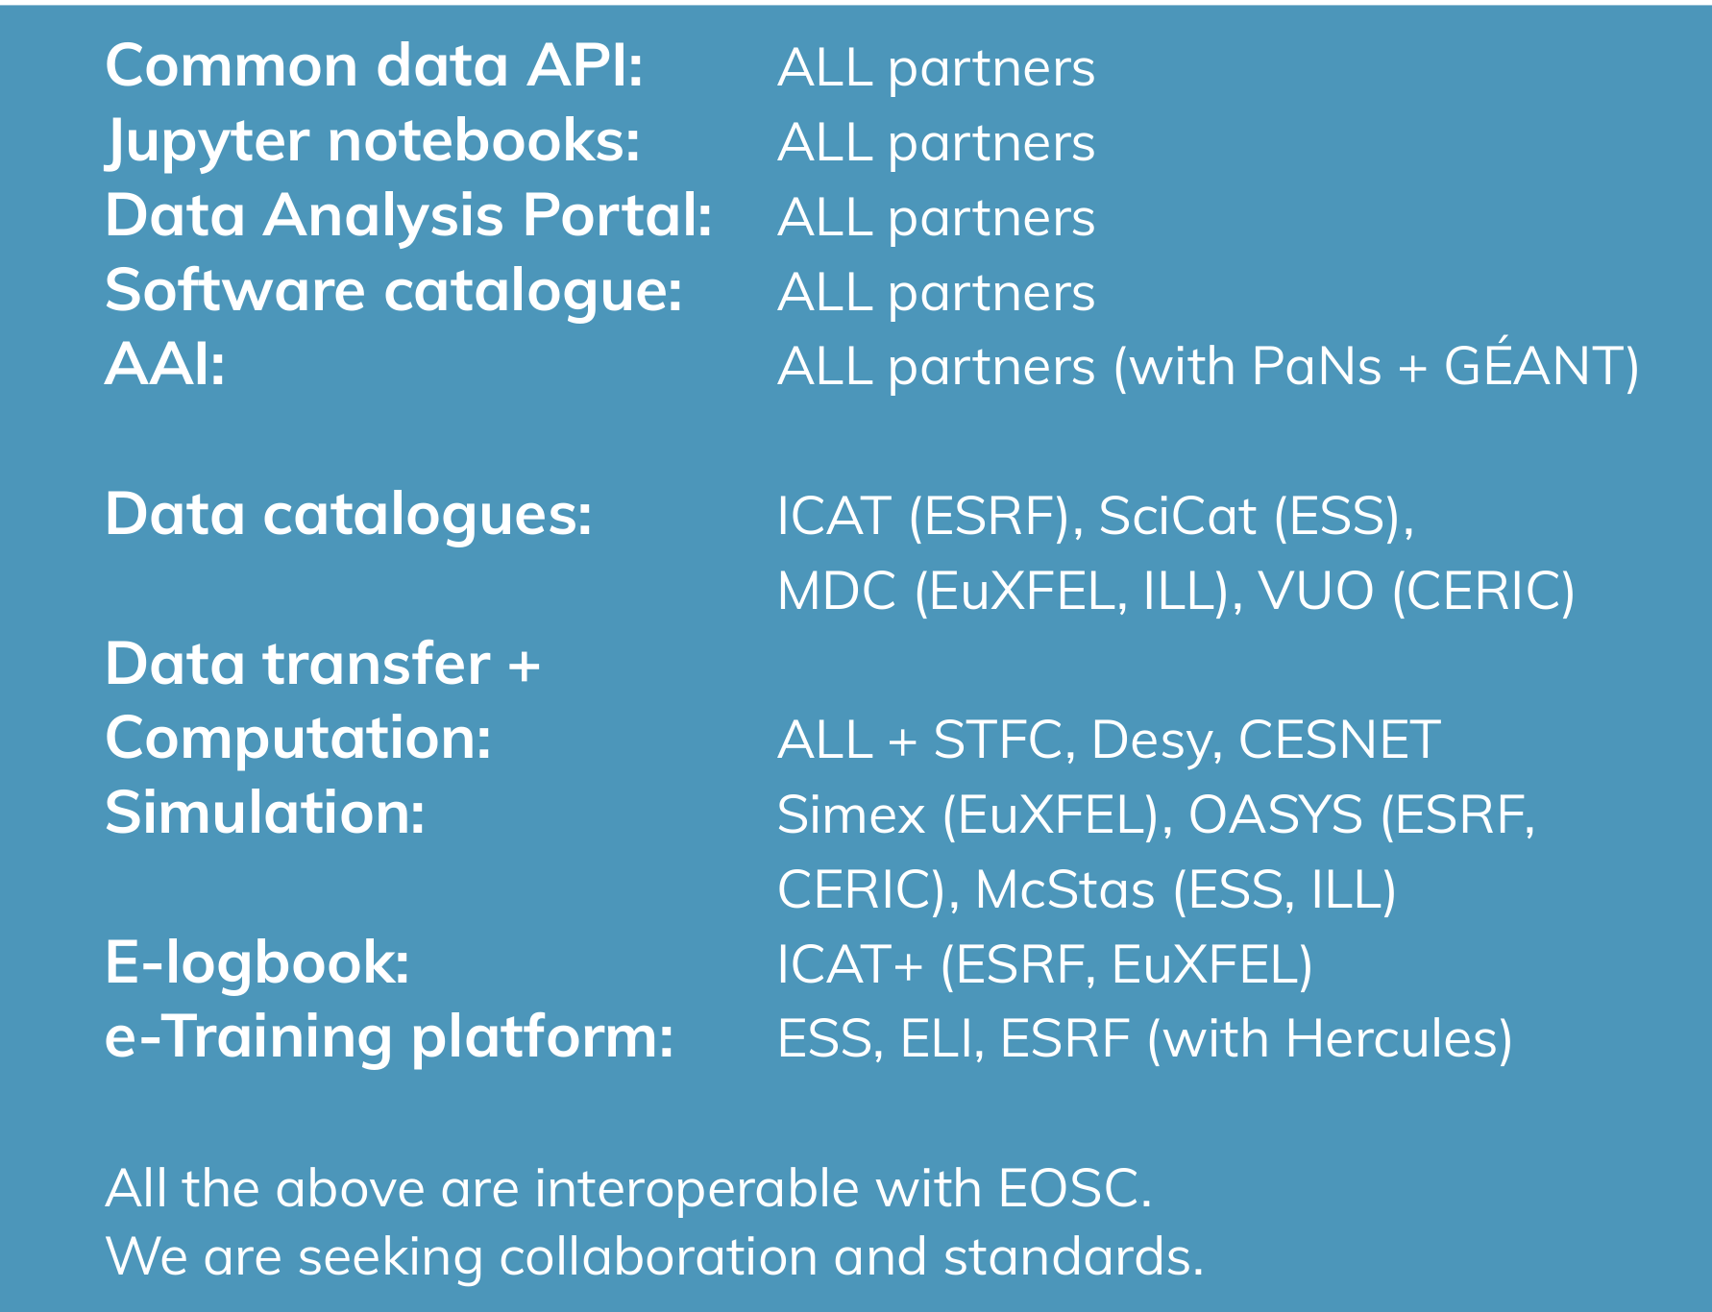
PaNOSC’s Developments
This project has received funding from the European Union’s Horizon 2020 research and innovation programme under grant agreement No. 823852

Slide 36
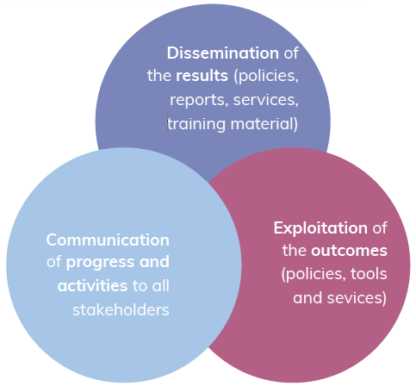
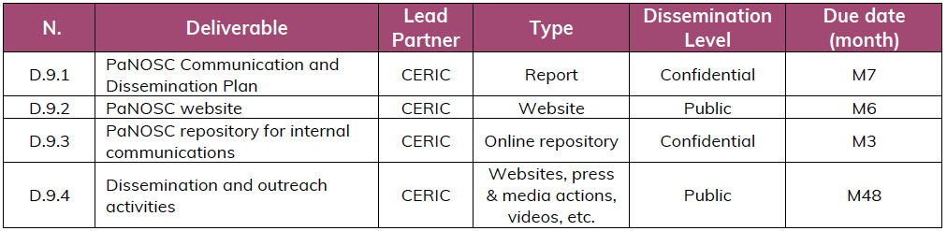
WP9
PaNOSC Communication
Collaboration with other EOSC projects and clusters
(share of updates on progress and developed policies, strategies, tools, technologies…)
+

